Slide 1
What Bile has Taught Me, etc.
I2C Bus Sharing
LIDAR pan & tilt scanning
LIDAR FOV, ROI, Accuracy
Encoders & PID
ROV-E

Slide 2
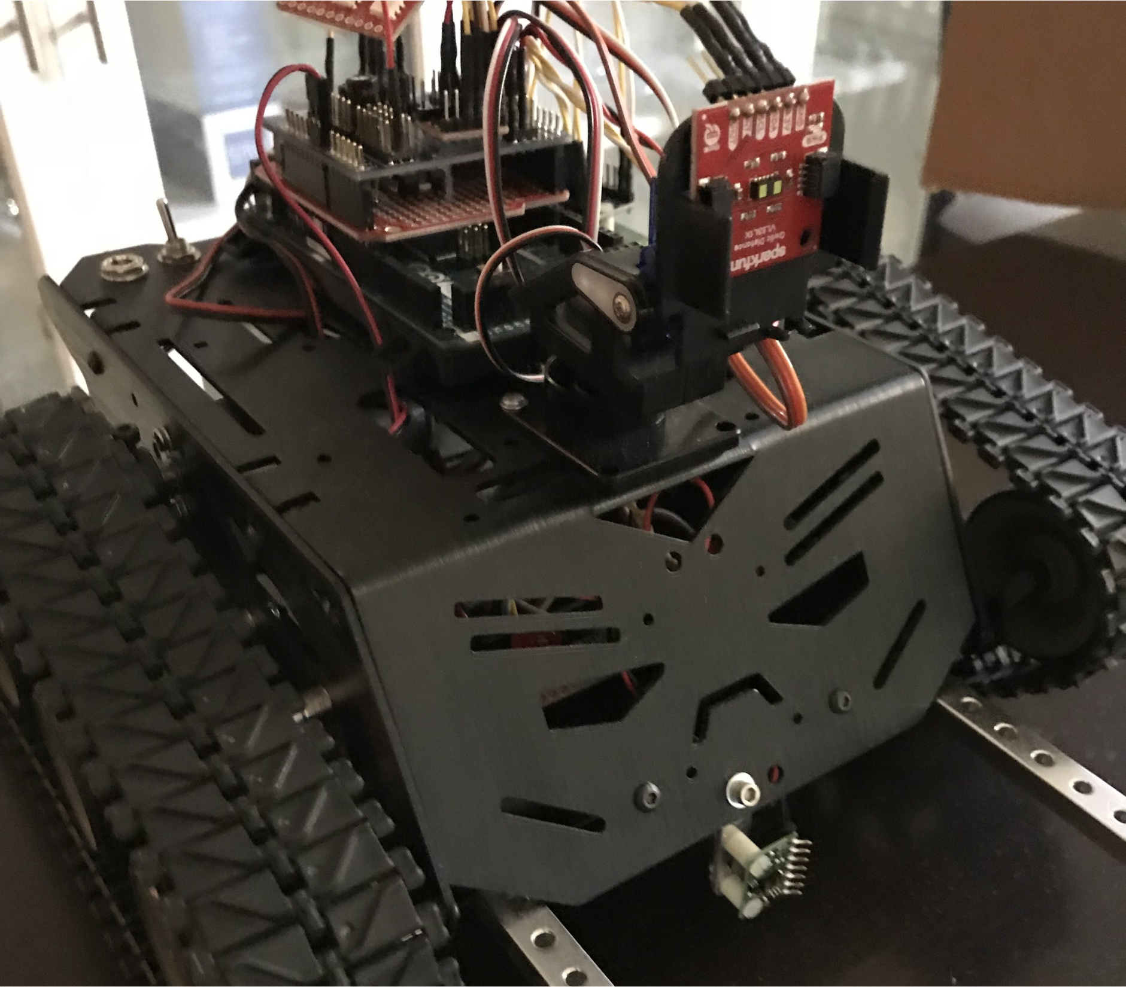

Slide 3
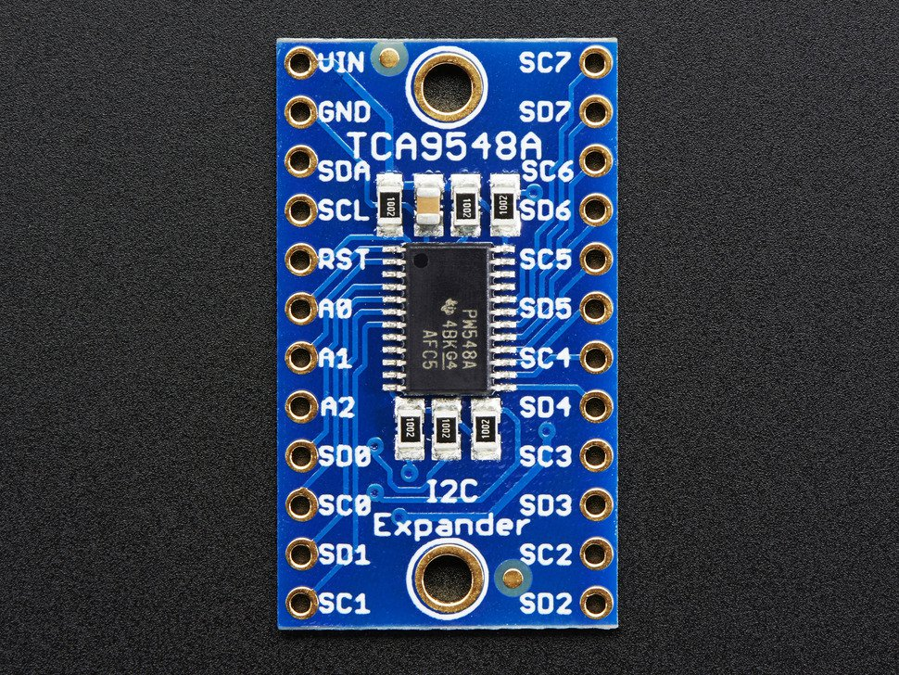
I2C Expander (Adafruit # 2717)

Slide 4
I2C Expander (Adafruit # 2717)
#define TCAADDR 0x70
void tcaselect(uint8_t i) {
if (i > 7) return;
Wire.beginTransmission(TCAADDR);
Wire.write(1 << i);
Wire.endTransmission();
}
tcaselect(0); // or 1, 2, etc.

Slide 5
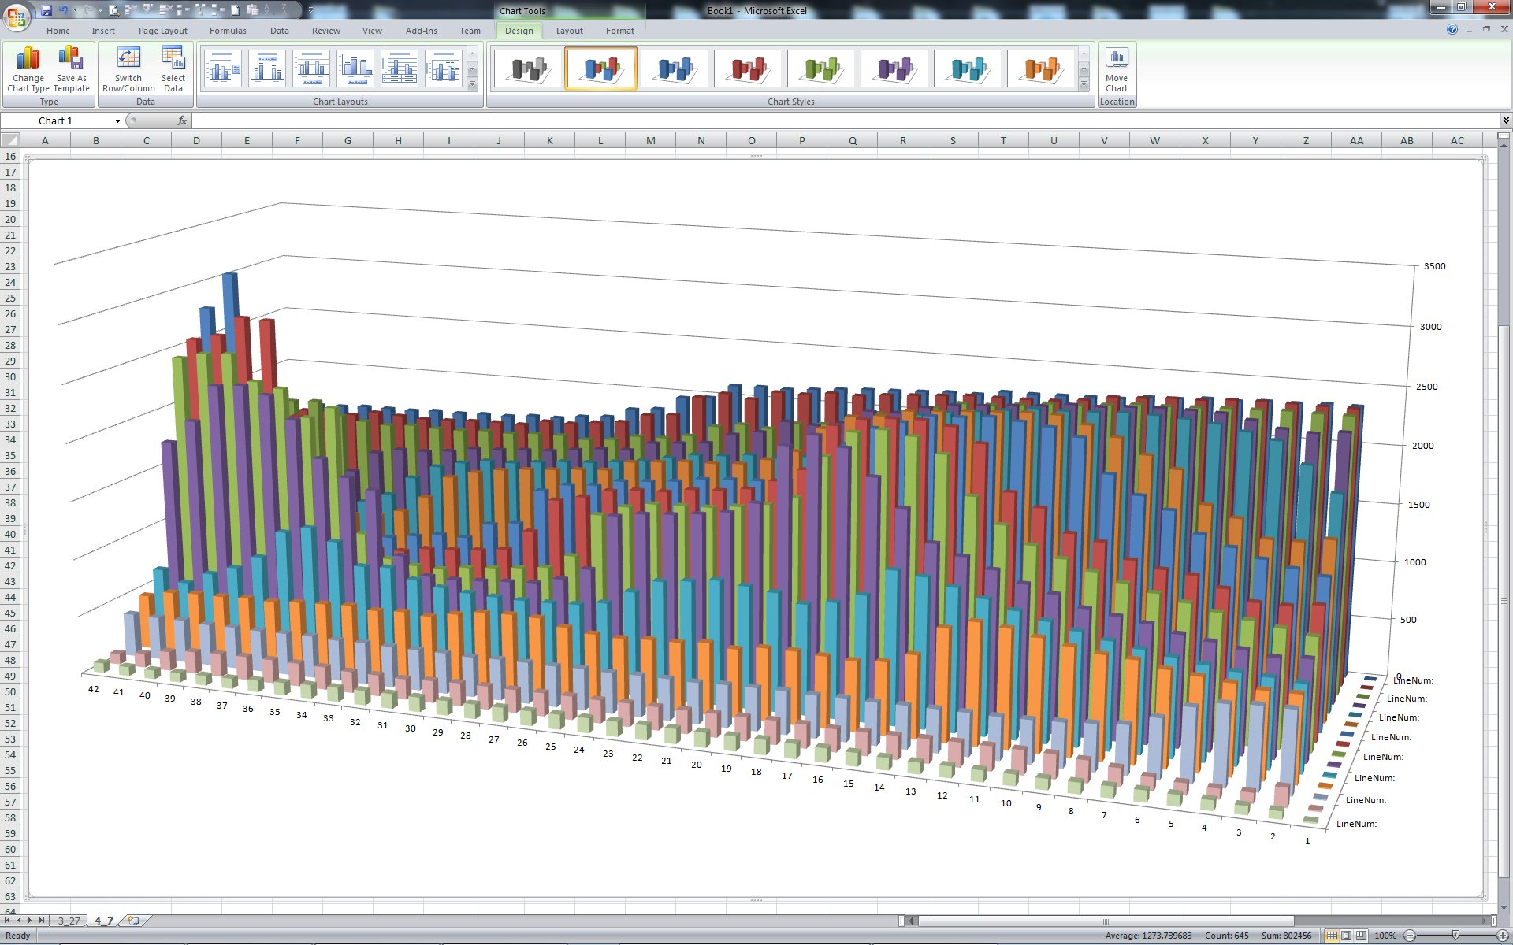
Where’s Waldo?

Slide 6
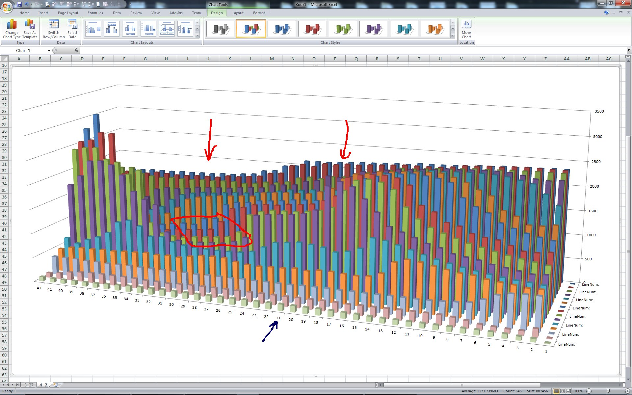
There he is!

Slide 7
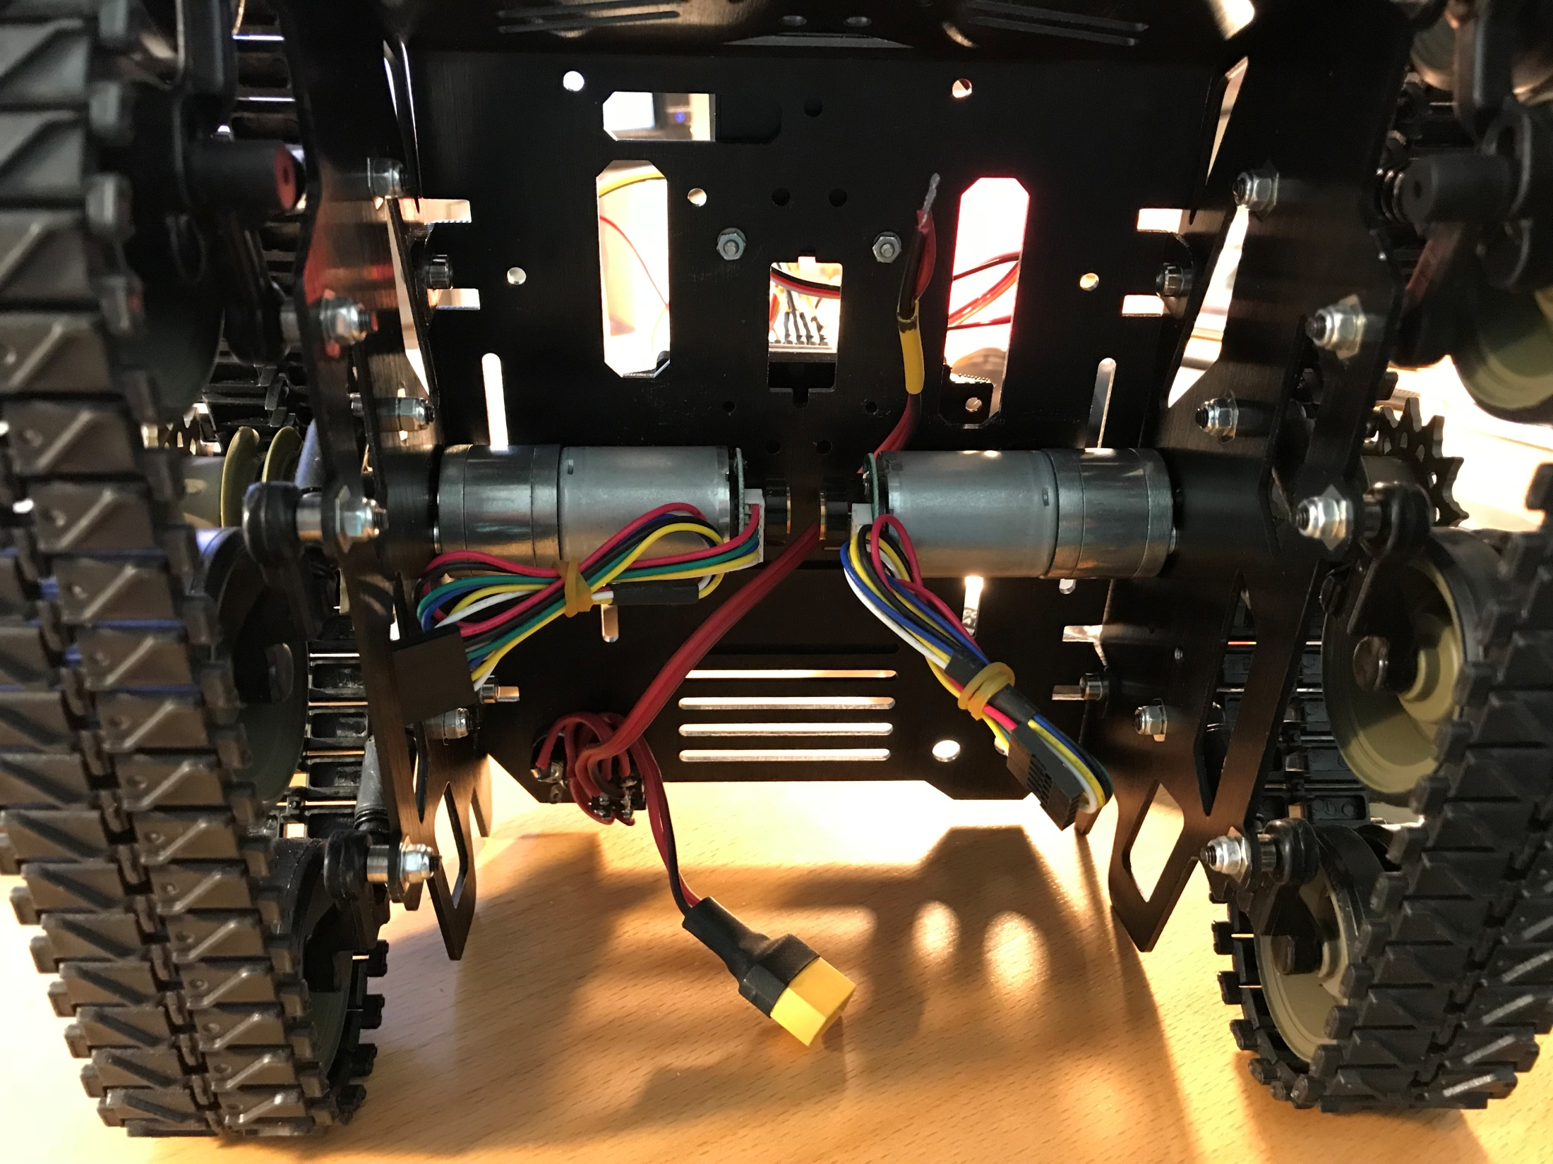

Slide 8
PID lite for Arduino
/*
PID control (proportional, integral, differential)
read encoders @ interval (100 ms), find count difference (IC)
reduce A or B throttle (T) until counts are equal (delta throttle: DT)
PID inputs:
interval count error (IC) = since last read (proportional)
accumulated count error (TC) = since start of move (integral)
interval count error change (IC_{n} - IC_{n-1}) = difference in IC since last read (differential)
delta throttle calculation:
DT = (Kp*IC + Ki*TC + Kd*(IC_{n} - IC_{n-1})) * speedLeft/255;
determine Kp, Ki, Kd experimentally
*/

Slide 9
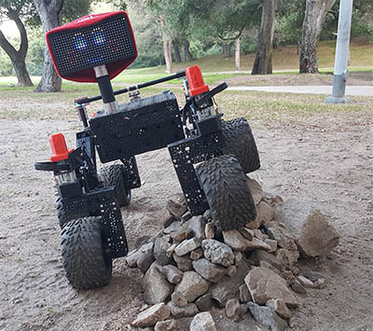
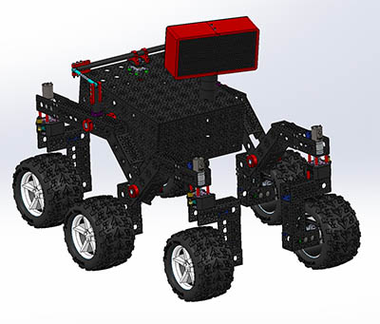
ROV-E

Slide 10

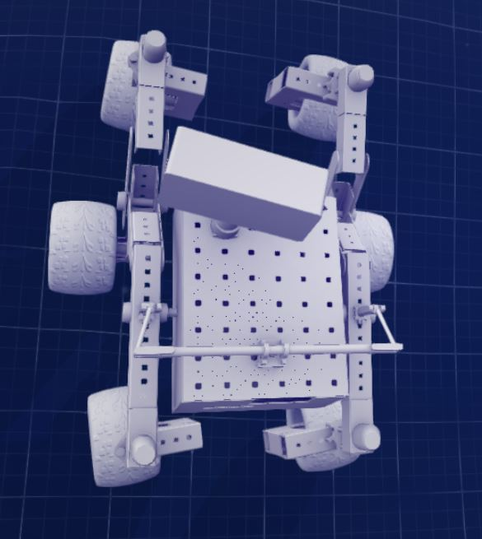
ROV-E

Slide 11
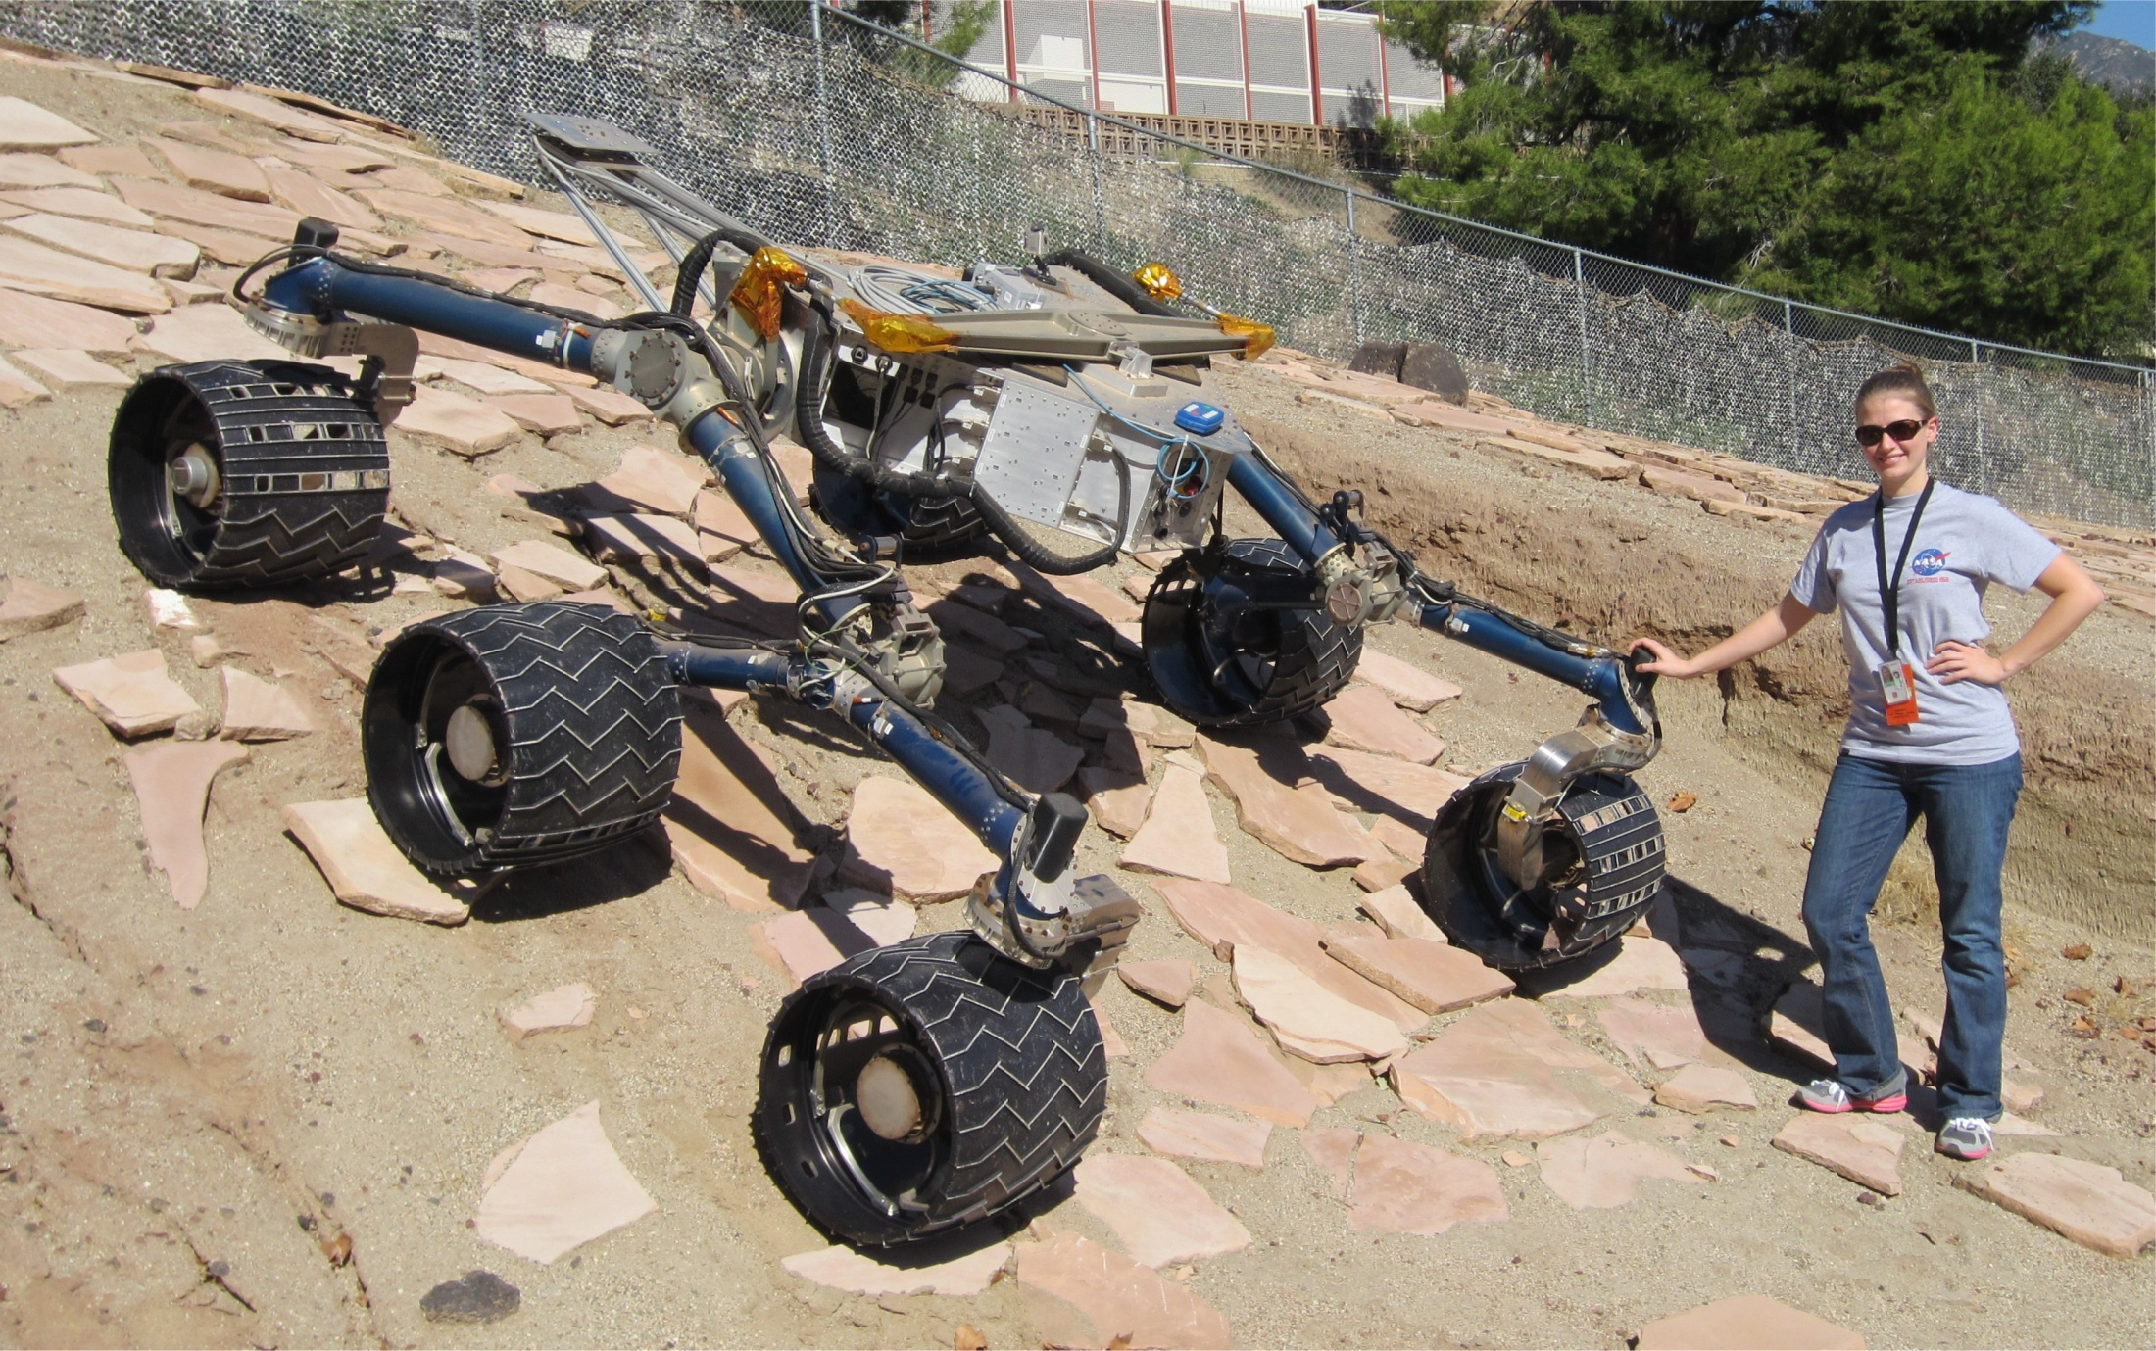

Slide 12
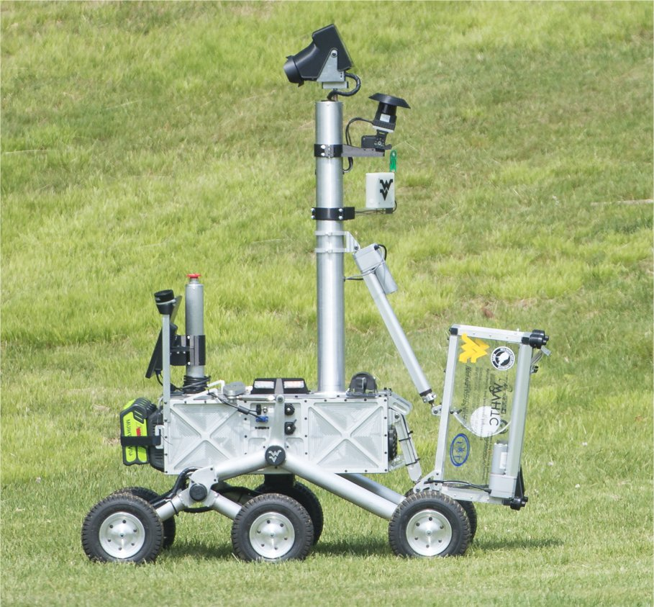

Slide 13
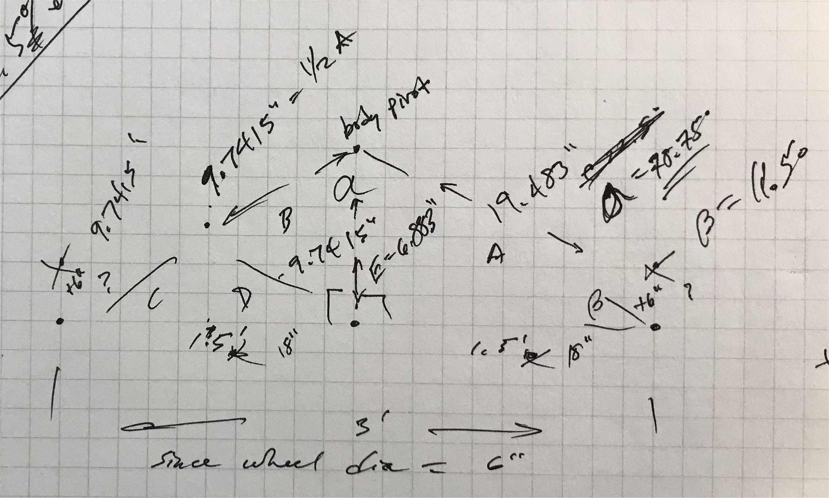
Calculations

Slide 14
BOM
Curiosity Killed the Cat
 |  | price | qty | ext
2" PVC
Charlotte Pipe 2-in x 10-ft 280 Sch 40 Solidcore PVC DWV Pipe | Item # 23832 Model # PVC 07200 0600 | $ 8.86 | 1 | $ 8.86 | Lowe's
Charlotte Pipe 2-in dia 45-Degree PVC Schedule 40 Elbow Fitting | Item # 23338 Model # PVC 00321 1000 | $ 1.08 | 2 | $ 2.16 | Lowe's
Charlotte Pipe 2-in dia PVC Cap Fitting | Item # 526972 Model # PVC 02116 1600 | $ 2.20 | 4 | $ 8.80 | Lowe's
3" PVC
Charlotte Pipe 3-in x 10-ft 260-PSI PVC Pipe | tem # 87669 Model # PVC 07300 0600 | $ 18.78 |  | $ - | Lowe's
Charlotte Pipe 3-in dia 45-Degree PVC Schedule 40 Elbow Fitting | Item # 23339 Model # PVC 00321 1200 | $ 2.84 |  | $ - | Lowe's
3-in dia PVC Cap Fitting | Item # 22686 Model # 3P06 | $ 1.98 |  | $ - | Lowe's
4" PVC
Charlotte Pipe 4-in x 10-ft 220-PSI PVC Pipe | Item # 87673 Model # PVC 07400 0600 | $ 19.08 |  | $ - | Lowe's
4-in dia 45-Degree PVC Elbow Fitting | Item # 24124 Model # 4P03 | $ 1.98 |  | $ - | Lowe's
4-in dia PVC Cap Fitting | Item # 24132 Model # 4P06 | $ 2.39 |  | $ - | Lowe's | green?
Wheels
6-3/4-in Dia PVC Sewer Drain Cap | Item # 122863 Model # 6P06 | $ 6.28 | 6 | $ 37.68 | Lowe's
misc
Oatey 8-fl oz PVC Cement And Primer | Item # 452387 Model # 30232L | $ 9.98 |  | $ - | Lowe's | all purpose
Oatey 8-fl oz PVC Cement And Primer | Item # 150887 Model # 30244L | $ 8.48 | 1 | $ 8.48 | Lowe's | med clear
Servos
CM-785HB Servo Gearbox | CM-785HB-7-A | $ 129.98 | 2 | $ 259.96 | Servo City | 1281 oz-in @6V
CM-D950TW-180 Servo Gearbox | CM-D950TW-180-7-S-L-A | $ 237.98 |  | $ - | Servo City | 2821 oz-in @6V | 3402 oz-in @7.4V
Standard Hub Shaft ServoBlock™ (24T Spline) | 637110 | $ 26.99 | 4 | $ 107.96 | Servo City
HS-645MG Servo | 32645S00 | $ 29.99 | 4 | $ 119.96 | Servo City | 133 oz-in @6V
HS-5645MG Servo (digital) | 35645S00 | $ 39.99 |  | $ -
misc
24.0” Aluminum Channel | 585466 | $ 15.99 | 4 | $ 63.96 | Servo City
Actobotics X-Rail 24" | 565074 | $ 7.99 |  | $ - | Servo City
 |  |  | total | $ 617.82

Slide 15
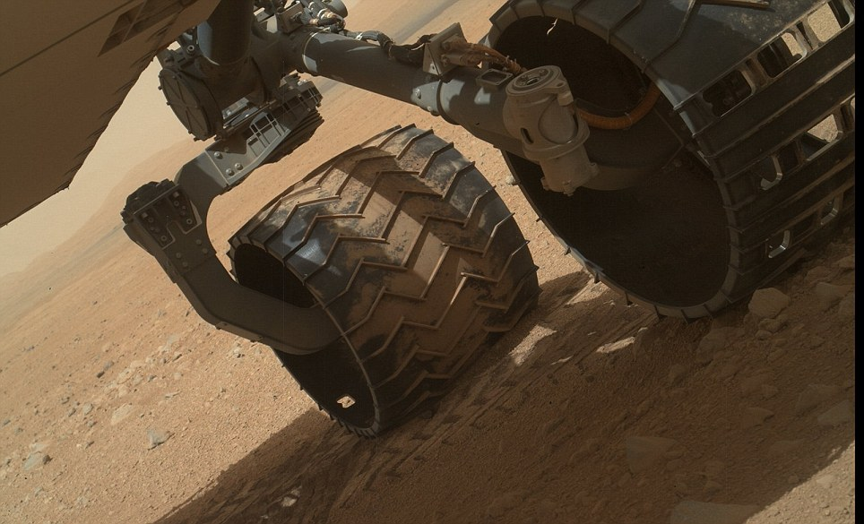

Slide 16
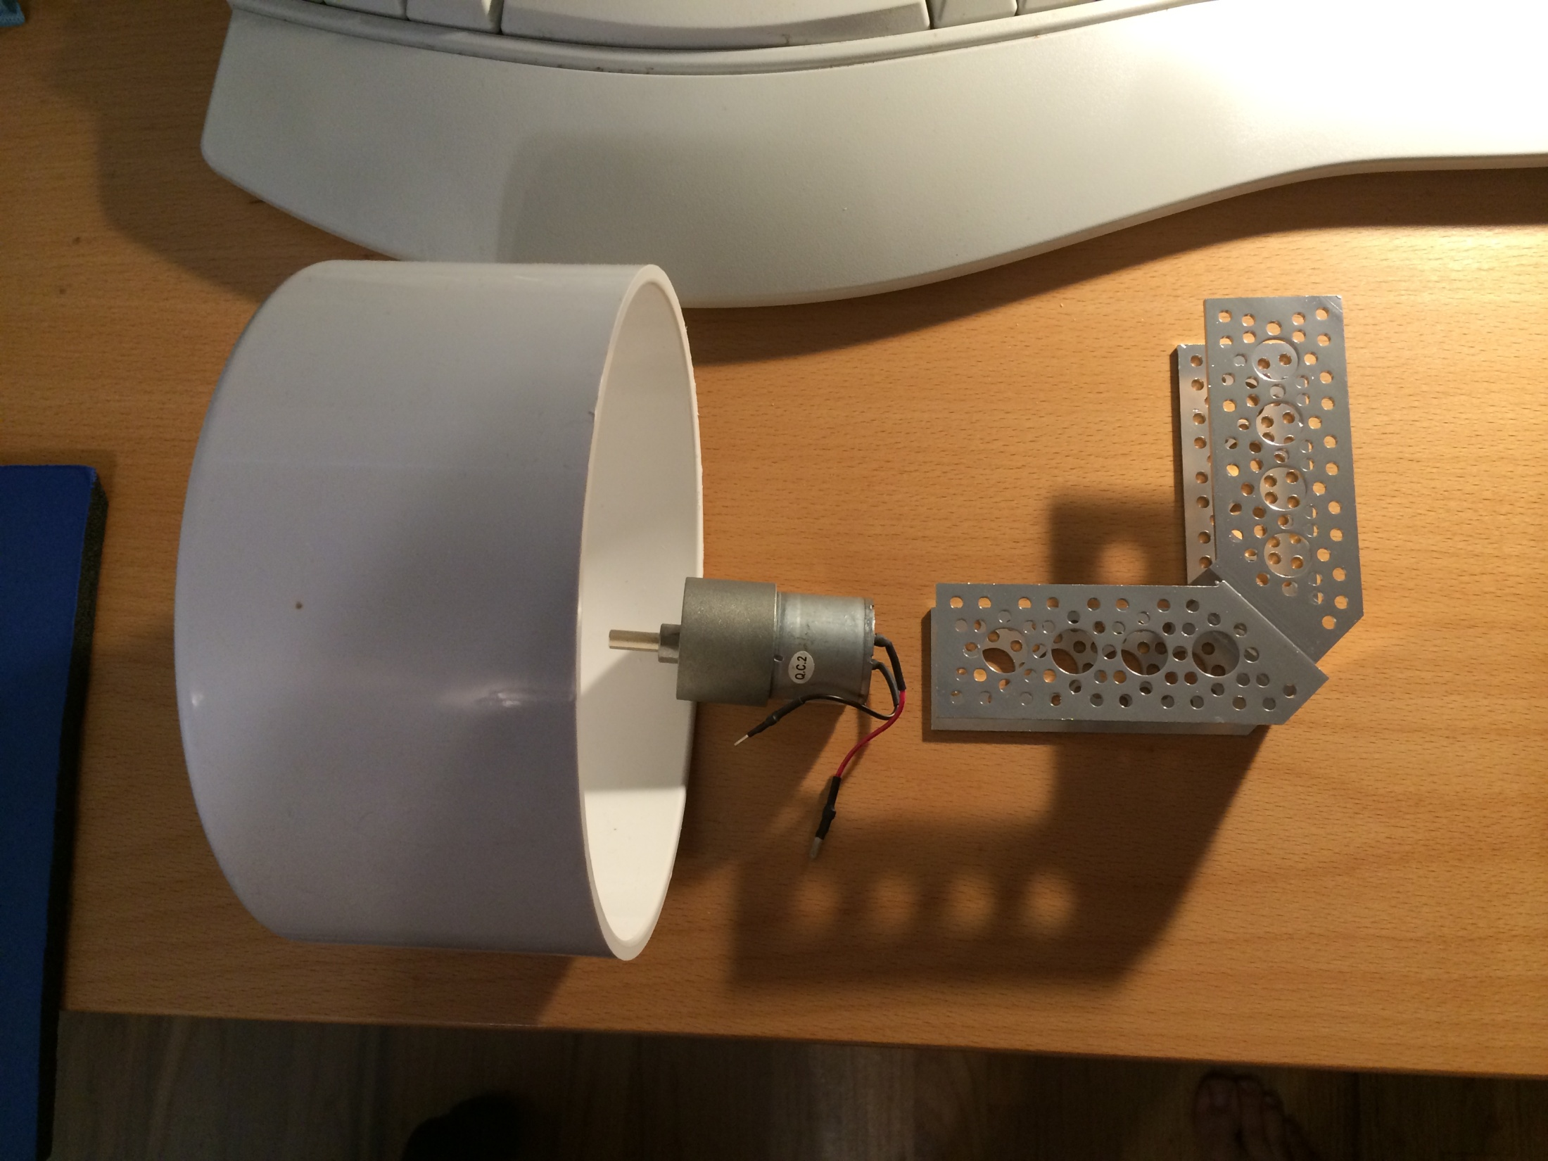

Slide 17
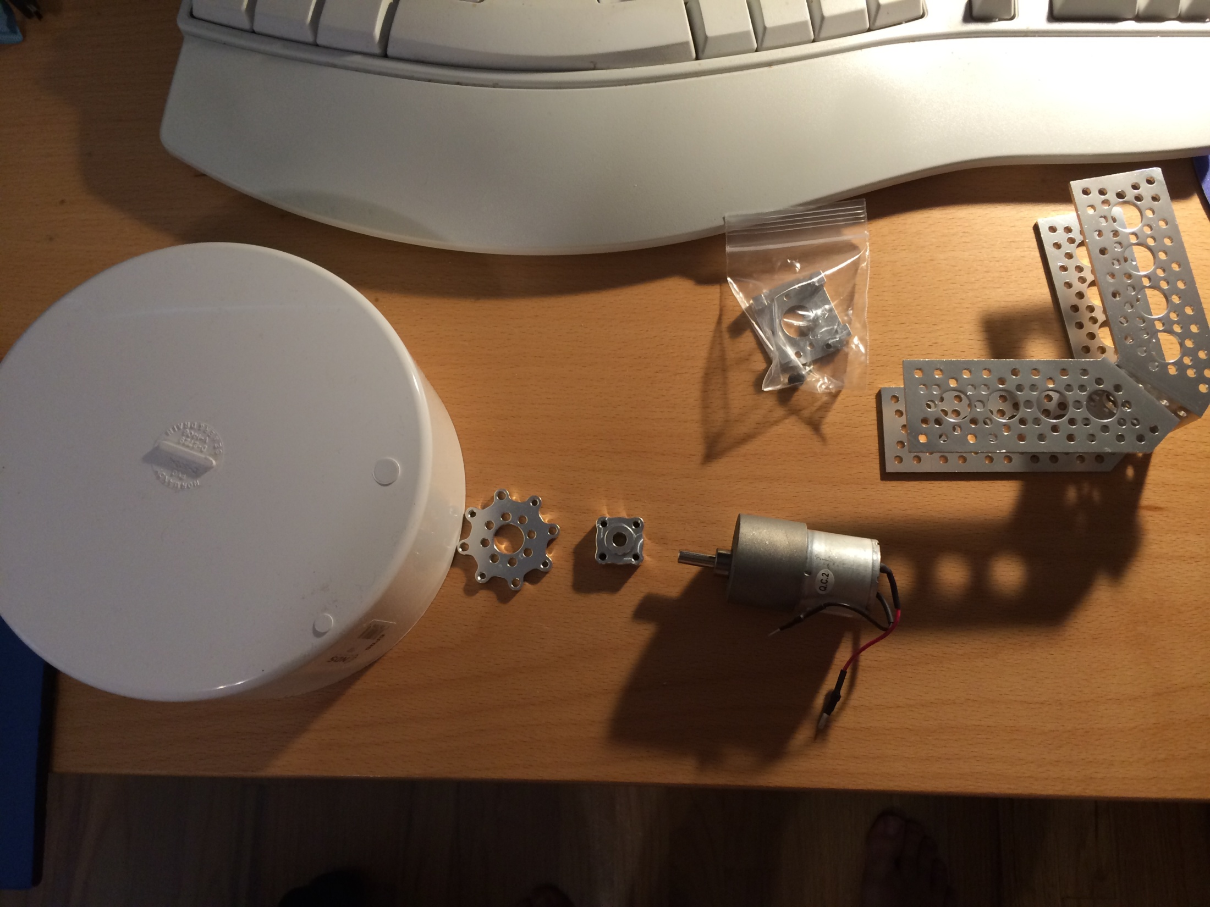

Slide 18
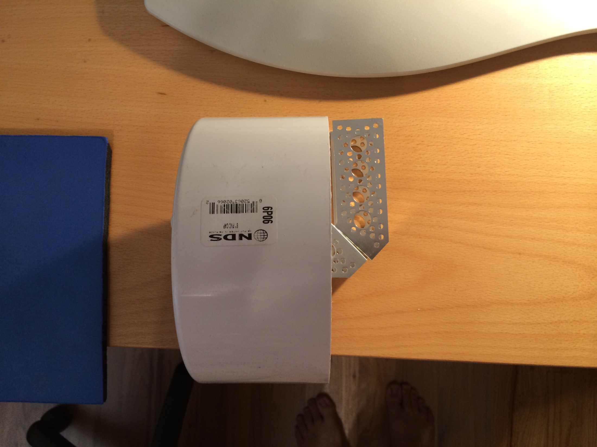

Slide 19
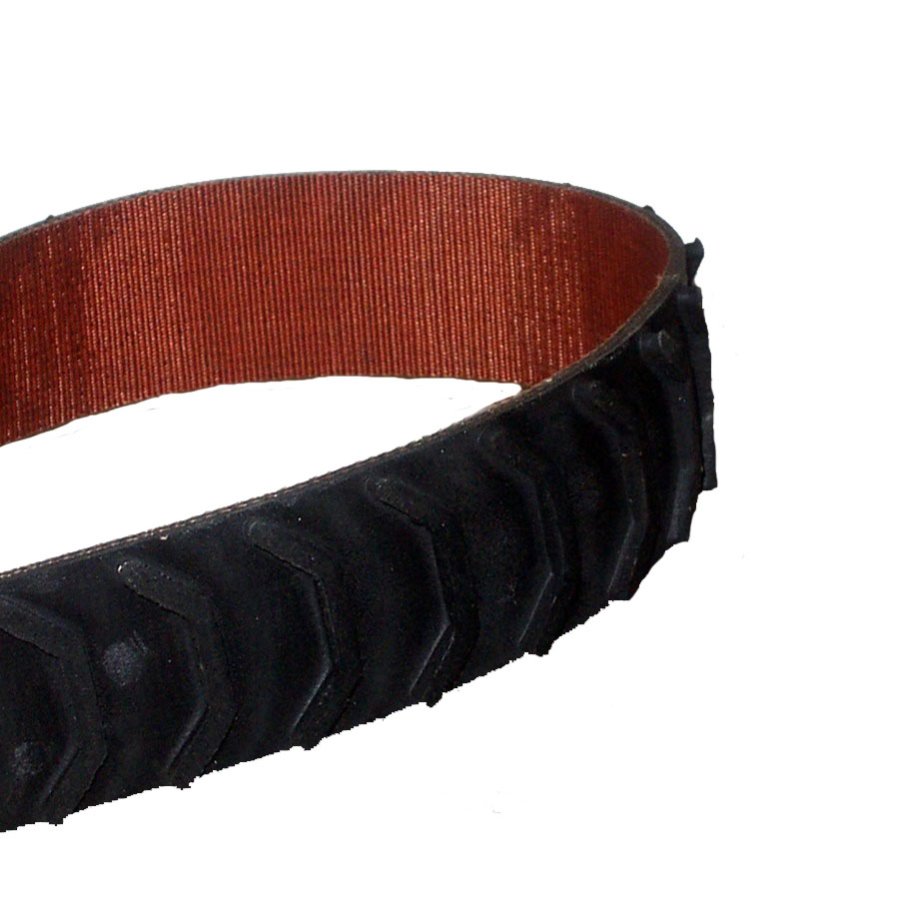

Slide 20
